Slide 1
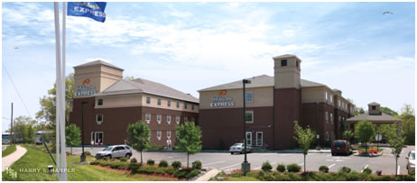
Outline
Holiday Inn Express
Additional Information
Introduction
Personal and Building Intro
Building Background
Building Size, Location, and Type
Current Budget and Schedule
Areas for Improvement/Client Influence
Analysis 1: Solyndra Solar Panel Implementation
Installation location
Sizing the Panel Layout
Schedule and Labor Analysis
Cost Analysis
Energy Savings Analysis/Payback
Analysis 2: SIP Panel Implementation
SIP Application
SIP vs. Stick Built
Material Cost
Schedule and Labor Analysis
Energy Savings Analysis/Payback
Analysis 3: BAS Systems
BAS System Application
Bathroom Nightlight motion Sensor
Hallway Motion Sensor
Motion Sensor PTAC
Conclusion
Final Schedule and Budget
Final Decisions (What and What Not to Proceed With)
Q/A
Thesis by: Josh Raphael
Architectural Engineering
Construction Management

Slide 2
Outline
Holiday Inn Express
Additional Information
Introduction
Personal and Building Intro
Building Background
Building Size, Location, and Type
Current Budget and Schedule
Areas for Improvement/Client Influence
Analysis 1: Solyndra Solar Panel Implementation
Installation location
Sizing the Panel Layout
Schedule and Labor Analysis
Cost Analysis
Energy Savings Analysis/Payback
Analysis 2: SIP Panel Implementation
SIP Application
SIP vs. Stick Built
Material Cost
Schedule and Labor Analysis
Energy Savings Analysis/Payback
Analysis 3: BAS Systems
BAS System Application
Bathroom Nightlight motion Sensor
Hallway Motion Sensor
Motion Sensor PTAC
Conclusion
Final Schedule and Budget
Final Decisions (What and What Not to Proceed With)
Q/A
Building Background
Location - 655 White Horse Pike, Absecon, NJ
Mixed Separate Use Group – R-1 Residential/ A-3 Assembly
Construction Type – V-B
Addition Area
First Floor (A-3): 4,912 ft²
First Floor (R-1): 6,475 ft²
Second Floor (R-1): 7,984 ft²
Third Floor (R-1): 7,984 ft²
Total initial Cost - $4 Million
Date of Construction – March 2009 – April 2010
Owner – Renuka Hospitality, LLC
General Contractor – DRK Associates
Architect – Harry S. Harper Architects

Slide 3
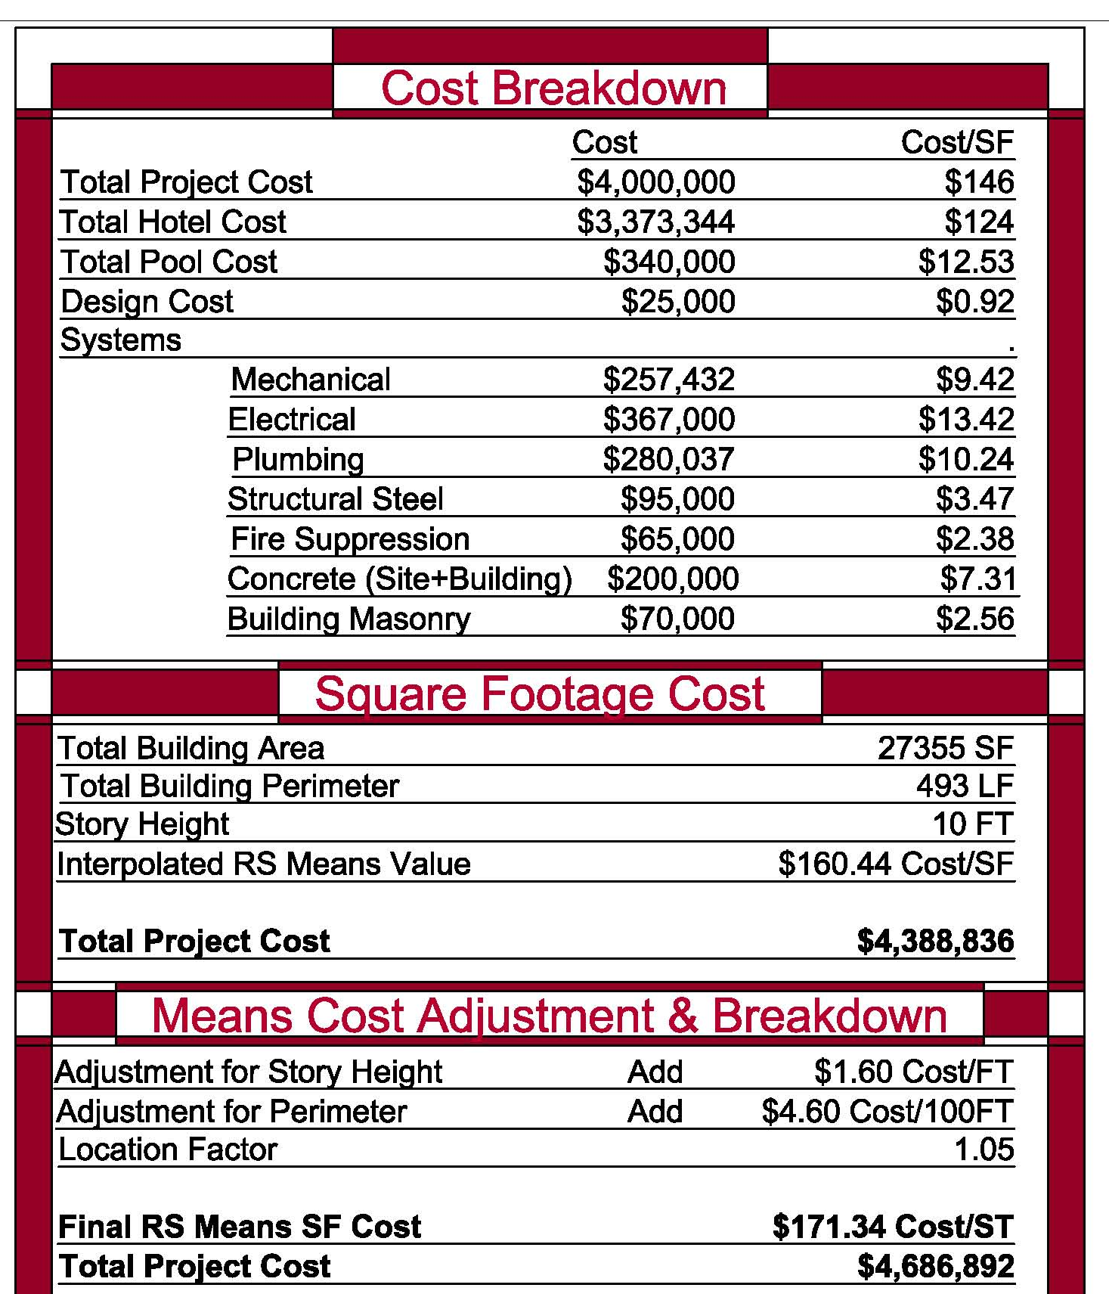
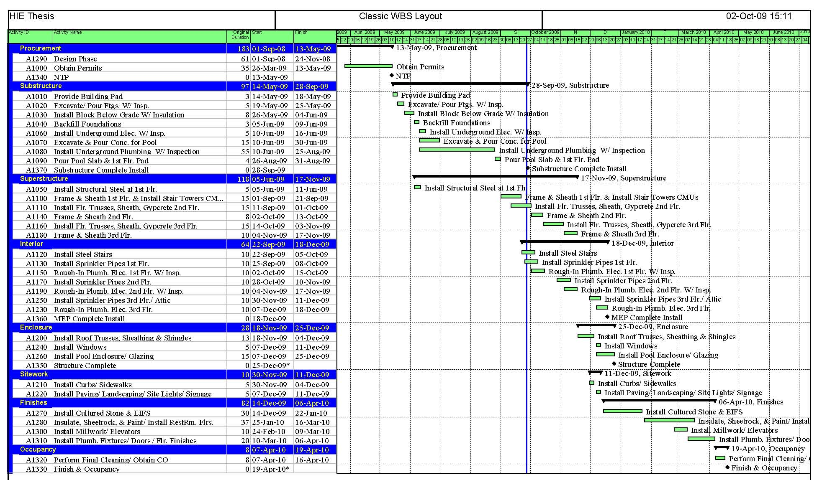
Outline
Holiday Inn Express
Additional Information
Introduction
Personal and Building Intro
Building Background
Building Size, Location, and Type
Current Budget and Schedule
Areas for Improvement/Client Influence
Analysis 1: Solyndra Solar Panel Implementation
Installation location
Sizing the Panel Layout
Schedule and Labor Analysis
Cost Analysis
Energy Savings Analysis/Payback
Analysis 2: SIP Panel Implementation
SIP Application
SIP vs. Stick Built
Material Cost
Schedule and Labor Analysis
Energy Savings Analysis/Payback
Analysis 3: BAS Systems
BAS System Application
Bathroom Nightlight motion Sensor
Hallway Motion Sensor
Motion Sensor PTAC
Conclusion
Final Schedule and Budget
Final Decisions (What and What Not to Proceed With)
Q/A
Current Budget & Schedule
Schedule Summary
Project Duration – 13 Months
Milestones
Substructure Complete
MEP Installation Complete
Building Structure Complete
Cost Summary
Approximate Project Cost – $4 Million (Owner Estimate)
Approximate Project Cost - $4.7 Million (Square Ft Estimate)

Slide 4
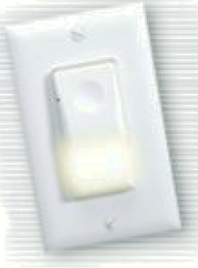
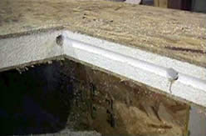
Outline
Holiday Inn Express
Additional Information
Introduction
Personal and Building Intro
Building Background
Building Size, Location, and Type
Current Budget and Schedule
Areas for Improvement/Client Influence
Analysis 1: Solyndra Solar Panel Implementation
Installation location
Sizing the Panel Layout
Schedule and Labor Analysis
Cost Analysis
Energy Savings Analysis/Payback
Analysis 2: SIP Panel Implementation
SIP Application
SIP vs. Stick Built
Material Cost
Schedule and Labor Analysis
Energy Savings Analysis/Payback
Analysis 3: BAS Systems
BAS System Application
Bathroom Nightlight motion Sensor
Hallway Motion Sensor
Motion Sensor PTAC
Conclusion
Final Schedule and Budget
Final Decisions (What and What Not to Proceed With)
Q/A
Areas for Improvement/Client Influence
Issues
Guest Waste Energy
Bathroom Night lighting
Lighting, Heating, & Cooling During Vacancy
Heating & Cooling Loss from Stud Wall Construction
Lack of Energy Efficiency Efforts
Solutions
Solyndra Solar Panel Installation
SIP Panel Implementation
BAS Systems

Slide 5
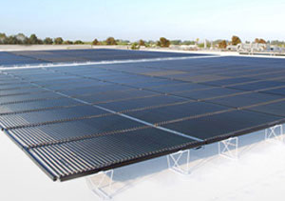
Outline
Holiday Inn Express
Additional Information
Introduction
Personal and Building Intro
Building Background
Building Size, Location, and Type
Current Budget and Schedule
Areas for Improvement/Client Influence
Analysis 1: Solyndra Solar Panel Implementation
Installation location
Sizing the Panel Layout
Schedule and Labor Analysis
Cost Analysis
Energy Savings Analysis/Payback
Analysis 2: SIP Panel Implementation
SIP Application
SIP vs. Stick Built
Material Cost
Schedule and Labor Analysis
Energy Savings Analysis/Payback
Analysis 3: BAS Systems
BAS System Application
Bathroom Nightlight motion Sensor
Hallway Motion Sensor
Motion Sensor PTAC
Conclusion
Final Schedule and Budget
Final Decisions (What and What Not to Proceed With)
Q/A
Analysis 1:
Solyndra Solar Panels

Slide 6
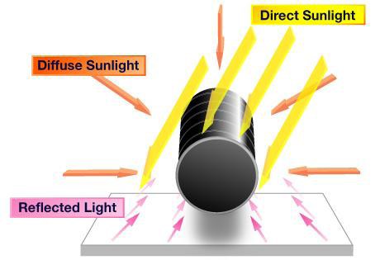
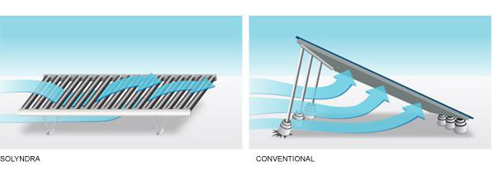
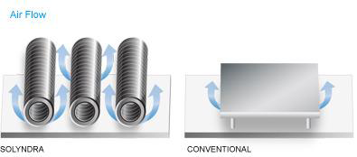
Outline
Holiday Inn Express
Additional Information
Introduction
Personal and Building Intro
Building Background
Building Size, Location, and Type
Current Budget and Schedule
Areas for Improvement/Client Influence
Analysis 1: Solyndra Solar Panel Implementation
Installation location
Sizing the Panel Layout
Schedule and Labor Analysis
Cost Analysis
Energy Savings Analysis/Payback
Analysis 2: SIP Panel Implementation
SIP Application
SIP vs. Stick Built
Material Cost
Schedule and Labor Analysis
Energy Savings Analysis/Payback
Analysis 3: BAS Systems
BAS System Application
Bathroom Nightlight motion Sensor
Hallway Motion Sensor
Motion Sensor PTAC
Conclusion
Final Schedule and Budget
Final Decisions (What and What Not to Proceed With)
Q/A
About Solyndra Solar Panels
Cylindrical PV Tubes – 360º Absorption (Direct, Diffuse, & Reflected Sunlight)
Most Efficient Solar Technology
Air Flow
Withstand Wind Up to 130mph (Absecon < 120mph)
Prevents Panel Overheating
Quick & Easy Installation – No need to mount
Greater Rooftop Coverage

Slide 7
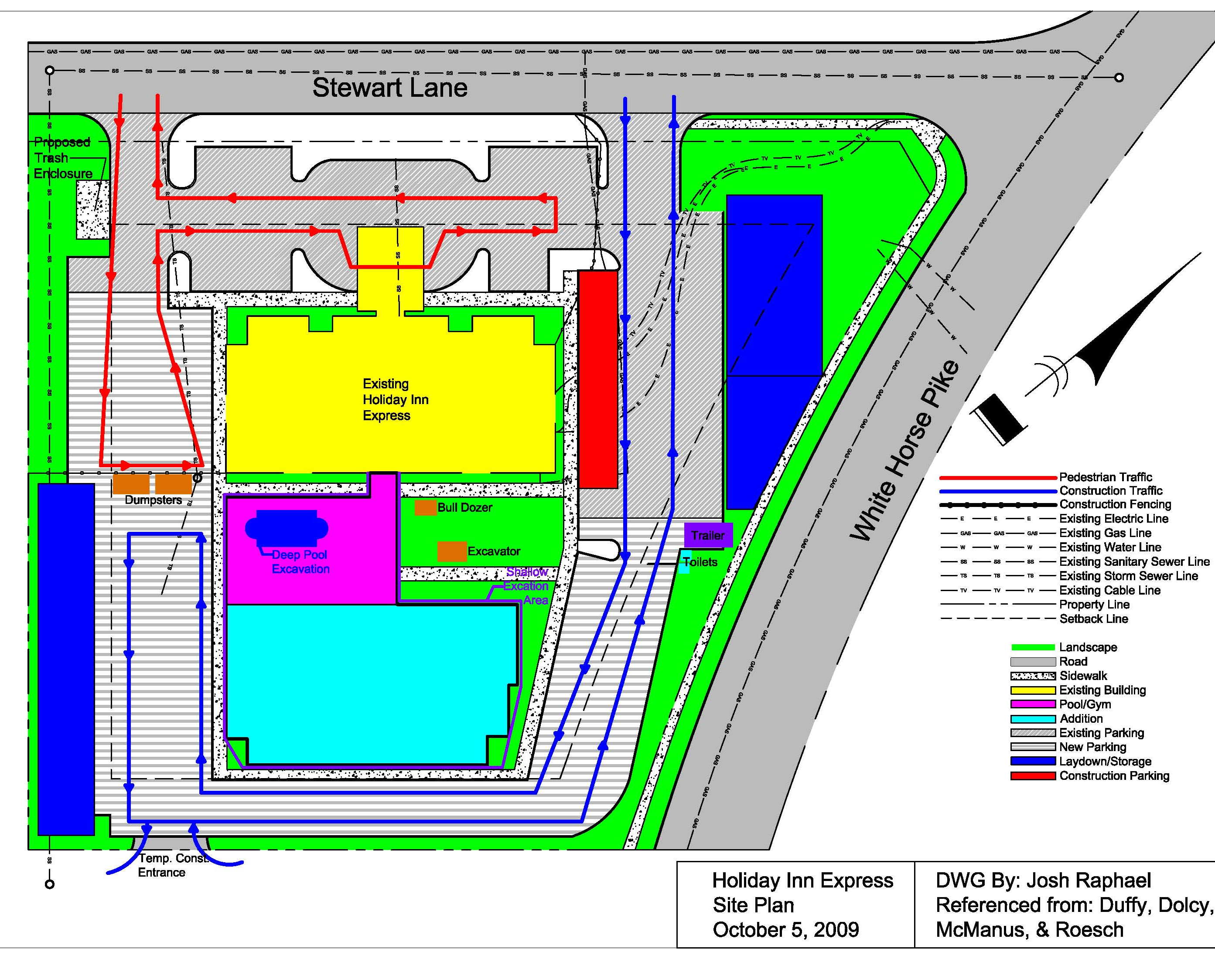
Outline
Holiday Inn Express
Additional Information
Introduction
Personal and Building Intro
Building Background
Building Size, Location, and Type
Current Budget and Schedule
Areas for Improvement/Client Influence
Analysis 1: Solyndra Solar Panel Implementation
Installation location
Sizing the Panel Layout
Schedule and Labor Analysis
Cost Analysis
Energy Savings Analysis/Payback
Analysis 2: SIP Panel Implementation
SIP Application
SIP vs. Stick Built
Material Cost
Schedule and Labor Analysis
Energy Savings Analysis/Payback
Analysis 3: BAS Systems
BAS System Application
Bathroom Nightlight motion Sensor
Hallway Motion Sensor
Motion Sensor PTAC
Conclusion
Final Schedule and Budget
Final Decisions (What and What Not to Proceed With)
Q/A
Installation Location
Location – South East Facing Roofs of Both the New & Existing Buildings (Green Shading)
Panel Size & Layout
Panel Size – 6’ x 3.5’
Panel Power – 191Wp Standard Test Conditions (Irradiance of 1000 W/m^2, air mass 1.5, and cell temperature of 25˚C)
Availiable Roof Area – 11760 ft²
Panel Count – 500 Panels
System Power – 95.5 kW Power

Slide 8
Outline
Holiday Inn Express
Additional Information
Introduction
Personal and Building Intro
Building Background
Building Size, Location, and Type
Current Budget and Schedule
Areas for Improvement/Client Influence
Analysis 1: Solyndra Solar Panel Implementation
Installation location
Sizing the Panel Layout
Schedule and Labor Analysis
Cost Analysis
Energy Savings Analysis/Payback
Analysis 2: SIP Panel Implementation
SIP Application
SIP vs. Stick Built
Material Cost
Schedule and Labor Analysis
Energy Savings Analysis/Payback
Analysis 3: BAS Systems
BAS System Application
Bathroom Nightlight motion Sensor
Hallway Motion Sensor
Motion Sensor PTAC
Conclusion
Final Schedule and Budget
Final Decisions (What and What Not to Proceed With)
Q/A
Schedule & labor Analysis
Labor Rate – 10 Panels/Hr, Using a 3 Man Crew
Installation Duration – 6.25 Days
Schedule Adjustment
Panel Installation Proceeding Roof Installment
Installation simultaneous with site work
Cost Analysis
Panel Material/Installation Cost – $5.42/W
Rebates
Federal - Investment Tax Credit(ITC) 30% of the Entire Energy System
State – Eliminates NJ State Tax of 7%
Final Cost per Watt - $4.13/W
Final System Cost – $394,041

Slide 9
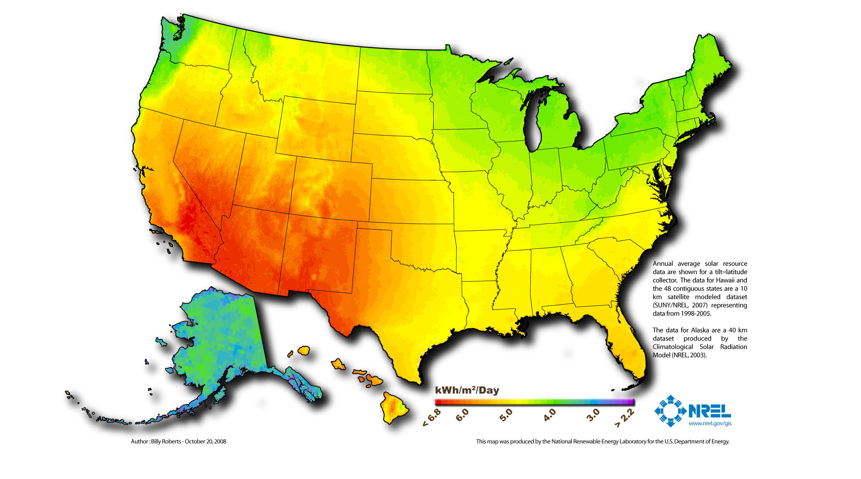
Outline
Holiday Inn Express
Additional Information
Introduction
Personal and Building Intro
Building Background
Building Size, Location, and Type
Current Budget and Schedule
Areas for Improvement/Client Influence
Analysis 1: Solyndra Solar Panel Implementation
Installation location
Sizing the Panel Layout
Schedule and Labor Analysis
Cost Analysis
Energy Savings Analysis/Payback
Analysis 2: SIP Panel Implementation
SIP Application
SIP vs. Stick Built
Material Cost
Schedule and Labor Analysis
Energy Savings Analysis/Payback
Analysis 3: BAS Systems
BAS System Application
Bathroom Nightlight motion Sensor
Hallway Motion Sensor
Motion Sensor PTAC
Conclusion
Final Schedule and Budget
Final Decisions (What and What Not to Proceed With)
Q/A
Energy Savings Analysis: Electrical Breadth
Average Solar Radiation – 4.67 kWh/m²/day
Absecon Electricity Cost – 13 ¢/kWh
Future Carbon Tax – Increased energy cost $0.1027 – $0.1137 /kWh
Carbon Footprint – Savings of 170,007 lbs of CO₂/yr
Energy Savings – 118,886 kWh
Cost Savings
No Carbon Tax - $15,455/yr
With Carbon Tax - $28,533/yr
Payback
Payback Period
No Carbon Tax – 25.5 years
With Carbon Tax – 13.8 Years

Slide 10
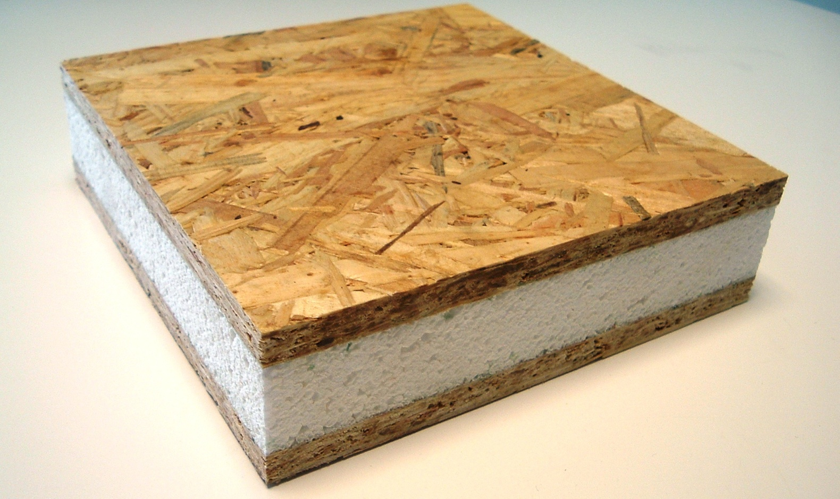
Outline
Holiday Inn Express
Additional Information
Introduction
Personal and Building Intro
Building Background
Building Size, Location, and Type
Current Budget and Schedule
Areas for Improvement/Client Influence
Analysis 1: Solyndra Solar Panel Implementation
Installation location
Sizing the Panel Layout
Schedule and Labor Analysis
Cost Analysis
Energy Savings Analysis/Payback
Analysis 2: SIP Panel Implementation
SIP Application
SIP vs. Stick Built
Material Cost
Schedule and Labor Analysis
Energy Savings Analysis/Payback
Analysis 3: BAS Systems and Wireless Controls
BAS System Application
Bathroom Nightlight motion Sensor
Hallway Motion Sensor
Motion Sensor PTAC
Conclusion
Final Schedule and Budget
Final Decisions (What and What Not to Proceed With)
Q/A
Analysis 2:
Structural Insulated Panels

Slide 11
Outline
Holiday Inn Express
Additional Information
Introduction
Personal and Building Intro
Building Background
Building Size, Location, and Type
Current Budget and Schedule
Areas for Improvement/Client Influence
Analysis 1: Solyndra Solar Panel Implementation
Installation location
Sizing the Panel Layout
Schedule and Labor Analysis
Cost Analysis
Energy Savings Analysis/Payback
Analysis 2: SIP Panel Implementation
SIP Application
SIP vs. Stick Built
Material Cost
Schedule and Labor Analysis
Energy Savings Analysis/Payback
Analysis 3: BAS Systems
BAS System Application
Bathroom Nightlight motion Sensor
Hallway Motion Sensor
Motion Sensor PTAC
Conclusion
Final Schedule and Budget
Final Decisions (What and What Not to Proceed With)
Q/A
About SIP Panels
Structurally Sound – Stronger & Straighter
R – Value – R 24.7 compared to R19
Prefabrication – Lower on Site Labor Cost
Labor – 50-70% Faster
SIP Application
Exterior Wall - 6” SIP Panel vs. 2 x 6” Stud Construction
Location – 1st, 2nd, & 3rd Floor Addition Exterior Walls
Exterior Wall Area – 15,274 ft²

Slide 12
Outline
Holiday Inn Express
Additional Information
Introduction
Personal and Building Intro
Building Background
Building Size, Location, and Type
Current Budget and Schedule
Areas for Improvement/Client Influence
Analysis 1: Solyndra Solar Panel Implementation
Installation location
Sizing the Panel Layout
Schedule and Labor Analysis
Cost Analysis
Energy Savings Analysis/Payback
Analysis 2: SIP Panel Implementation
SIP Application
SIP vs. Stick Built
Material Cost
Schedule and Labor Analysis
Energy Savings Analysis/Payback
Analysis 3: BAS Systems and Wireless Controls
BAS System Application
Bathroom Nightlight motion Sensor
Hallway Motion Sensor
Motion Sensor PTAC
Conclusion
Final Schedule and Budget
Final Decisions (What and What Not to Proceed With)
Q/A
SIP vs. Stick Built
Material Cost
Initial Cost of SIP Panels - $60,188
Budget Increase - $14,690, about 33% more expensive than Stick Built
Schedule & Labor Analysis
Current Framing Duration – 26 Days (All 3 Floors)
New Framing Duration – 17 Days ( All 3 Floors)
Estimated Schedule Reduction – 50%, 4 Days/Floor
Schedule Reduction – 3 Days/Floor (Learning Curve)
Total Reduction – 9 Days

Slide 13
Outline
Holiday Inn Express
Additional Information
Introduction
Personal and Building Intro
Building Background
Building Size, Location, and Type
Current Budget and Schedule
Areas for Improvement/Client Influence
Analysis 1: Solyndra Solar Panel Implementation
Installation location
Sizing the Panel Layout
Schedule and Labor Analysis
Cost Analysis
Energy Savings Analysis/Payback
Analysis 2: SIP Panel Implementation
SIP Application
SIP vs. Stick Built
Material Cost
Schedule and Labor Analysis
Energy Savings Analysis/Payback
Analysis 3: BAS Systems
BAS System Application
Bathroom Nightlight motion Sensor
Hallway Motion Sensor
Motion Sensor PTAC
Conclusion
Final Schedule and Budget
Final Decisions (What and What Not to Proceed With)
Q/A
Energy Efficiency Analysis: Mechanical Breadth
Leakage
2 x 6” (Poor Leakage) – 857 MBTU, 251,101 kWh
2 x 6” (Avg. Leakage) – 678 MBTU, 198,654 kWh
SIP Panel – 297 MBTU, 87,021 kWh
Energy Cost Absecon, NJ
2 x 6” (Poor Leakage) – $32,643
2 x 6” (Avg. Leakage) – $25,825
SIP Panel – $11,313
Savings (Avg. Leakage)- $14,512/yr
Payback
Payback Period – 1-2 years

Slide 14
Outline
Holiday Inn Express
Additional Information
Introduction
Personal and Building Intro
Building Background
Building Size, Location, and Type
Current Budget and Schedule
Areas for Improvement/Client Influence
Analysis 1: Solyndra Solar Panel Implementation
Installation location
Sizing the Panel Layout
Schedule and Labor Analysis
Cost Analysis
Energy Savings Analysis/Payback
Analysis 2: SIP Panel Implementation
SIP Application
SIP vs. Stick Built
Material Cost
Schedule and Labor Analysis
Energy Savings Analysis/Payback
Analysis 3: BAS Systems
BAS System Application
Bathroom Nightlight motion Sensor
Hallway Motion Sensor
Motion Sensor PTAC
Conclusion
Final Schedule and Budget
Final Decisions (What and What Not to Proceed With)
Q/A
Analysis 3:
Building Automated Systems

Slide 15
Outline
Holiday Inn Express
Additional Information
Introduction
Personal and Building Intro
Building Background
Building Size, Location, and Type
Current Budget and Schedule
Areas for Improvement/Client Influence
Analysis 1: Solyndra Solar Panel Implementation
Installation location
Sizing the Panel Layout
Schedule and Labor Analysis
Cost Analysis
Energy Savings Analysis/Payback
Analysis 2: SIP Panel Implementation
SIP Application
SIP vs. Stick Built
Material Cost
Schedule and Labor Analysis
Energy Savings Analysis/Payback
Analysis 3: BAS Systems
BAS System Application
Bathroom Nightlight motion Sensor
Hallway Motion Sensor
Motion Sensor PTAC
Conclusion
Final Schedule and Budget
Final Decisions (What and What Not to Proceed With)
Q/A
About BAS Systems
Product Suppliers – Prolighting, Lutron, Watt Stoppers
Use – Eliminate Energy Consumption During Vacancy
BAS System Application
3 Areas for Implementation
Bathroom Nightlight/Motion Sensor Switch
2. Hallway Motion Sensors
3. Motion Sensor PTAC

Slide 16
Outline
Holiday Inn Express
Additional Information
Introduction
Personal and Building Intro
Building Background
Building Size, Location, and Type
Current Budget and Schedule
Areas for Improvement/Client Influence
Analysis 1: Solyndra Solar Panel Implementation
Installation location
Sizing the Panel Layout
Schedule and Labor Analysis
Cost Analysis
Energy Savings Analysis/Payback
Analysis 2: SIP Panel Implementation
SIP Application
SIP vs. Stick Built
Material Cost
Schedule and Labor Analysis
Energy Savings Analysis/Payback
Analysis 3: BAS Systems
BAS System Application
Bathroom Nightlight motion Sensor
Hallway Motion Sensor
Motion Sensor PTAC
Conclusion
Final Schedule and Budget
Final Decisions (What and What Not to Proceed With)
Q/A
Bathroom Nightlight/Motion Sensor Switch
About
The switch shuts off energy when vacant
The switch acts as a low energy nightlight
Reasons
40% of Hotel guest use bathroom as nightlight
75% of fixture energy used when operating for more than 2 Hrs (Usually during guest vacancy)
Initial Cost
New Switch – $38/each, about $20 more than regular switches
Cost Increase - $980

Slide 17
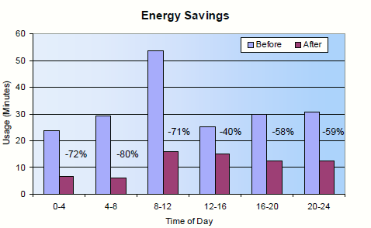
Outline
Holiday Inn Express
Additional Information
Introduction
Personal and Building Intro
Building Background
Building Size, Location, and Type
Current Budget and Schedule
Areas for Improvement/Client Influence
Analysis 1: Solyndra Solar Panel Implementation
Installation location
Sizing the Panel Layout
Schedule and Labor Analysis
Cost Analysis
Energy Savings Analysis/Payback
Analysis 2: SIP Panel Implementation
SIP Application
SIP vs. Stick Built
Material Cost
Schedule and Labor Analysis
Energy Savings Analysis/Payback
Analysis 3: BAS Systems
BAS System Application
Bathroom Nightlight motion Sensor
Hallway Motion Sensor
Motion Sensor PTAC
Conclusion
Final Schedule and Budget
Final Decisions (What and What Not to Proceed With)
Q/A
Bathroom Nightlight/Motion Sensor Switch
Energy Efficiency Analysis: Electrical Breadth
Bathroom lighting – 3 (100W) Incandescent
Typical Energy Usage – 190 min/day
Energy Usage W/ New Switch – 68 min/day
Daily Use Reduction –122min/day/unit
Annual Energy Savings – 16,993 kWh/year
Annual Cost Savings - $2,210/year
Payback
Payback Period - .5 years

Slide 18
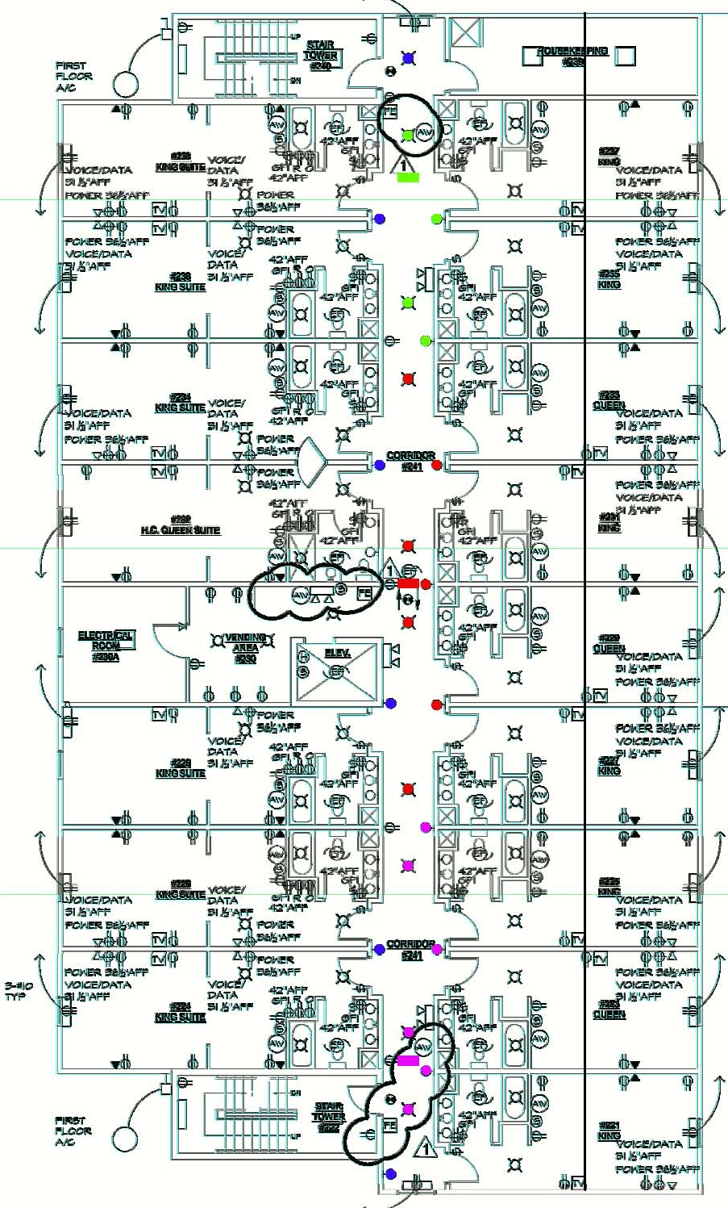
Outline
Holiday Inn Express
Additional Information
Introduction
Personal and Building Intro
Building Background
Building Size, Location, and Type
Current Budget and Schedule
Areas for Improvement/Client Influence
Analysis 1: Solyndra Solar Panel Implementation
Installation location
Sizing the Panel Layout
Schedule and Labor Analysis
Cost Analysis
Energy Savings Analysis/Payback
Analysis 2: SIP Panel Implementation
SIP Application
SIP vs. Stick Built
Material Cost
Schedule and Labor Analysis
Energy Savings Analysis/Payback
Analysis 3: BAS Systems
BAS System Application
Bathroom Nightlight motion Sensor
Hallway Motion Sensor
Motion Sensor PTAC
Conclusion
Final Schedule and Budget
Final Decisions (What and What Not to Proceed With)
Q/A
Hallway Motion Sensor
About
RAB LOS2400H Smart Hallway Sensors
The sensors have a max viewing range of 16’ x 80’
Can control 2400W/sensor of lighting
Reasons/Application
Hallway vacancy between 11PM-6AM
Excessive emergency hallway lighting
Apply to 2nd & 3rd floor hallways
Initial Cost
Sensor Cost – $139/each, Total of $834
Labor Cost – 30$/each, Total of $180
Total Cost - $1,014
Design Layout
3 Sensors/Floor
Green - controls 4 lights
Red - controls 7 lights
Pink - controls 6 lights
Blue - 6 continuous emergency lights
Green & pink sensors are offset 46’ from center sensor
Clg. Mounted – 8’-8” AFF

Slide 19
Outline
Holiday Inn Express
Additional Information
Introduction
Personal and Building Intro
Building Background
Building Size, Location, and Type
Current Budget and Schedule
Areas for Improvement/Client Influence
Analysis 1: Solyndra Solar Panel Implementation
Installation location
Sizing the Panel Layout
Schedule and Labor Analysis
Cost Analysis
Energy Savings Analysis/Payback
Analysis 2: SIP Panel Implementation
SIP Application
SIP vs. Stick Built
Material Cost
Schedule and Labor Analysis
Energy Savings Analysis/Payback
Analysis 3: BAS Systems
BAS System Application
Bathroom Nightlight motion Sensor
Hallway Motion Sensor
Motion Sensor PTAC
Conclusion
Final Schedule and Budget
Final Decisions (What and What Not to Proceed With)
Q/A
Hallway Motion Sensor
Energy Efficiency Analysis: Electrical Breadth
Hallway lighting – 23 (100W) Incandescent
Daily Use Reduction –5Hrs/day/floor
# of Lights on Sensors – 17 Lights
Energy Consumption
Before – 40,296 kWh/year
After – 32,850 kWh/uear
Annual Energy Savings – 7,446 kWh/year
Annual Cost Savings - $968/year
Payback
Payback Period - 1year

Slide 20
Outline
Holiday Inn Express
Additional Information
Introduction
Personal and Building Intro
Building Background
Building Size, Location, and Type
Current Budget and Schedule
Areas for Improvement/Client Influence
Analysis 1: Solyndra Solar Panel Implementation
Installation location
Sizing the Panel Layout
Schedule and Labor Analysis
Cost Analysis
Energy Savings Analysis/Payback
Analysis 2: SIP Panel Implementation
SIP Application
SIP vs. Stick Built
Material Cost
Schedule and Labor Analysis
Energy Savings Analysis/Payback
Analysis 3: BAS Systems
BAS System Application
Bathroom Nightlight motion Sensor
Hallway Motion Sensor
Motion Sensor PTAC
Conclusion
Final Schedule and Budget
Final Decisions (What and What Not to Proceed With)
Q/A
Motion Sensor PTAC
About
Current System – 9000 BTU Amana PTAC unit
New System - 9000 BTU DigiSmart Amana PTAC unit w/ the DigiSmart Motion Sensor
Typical savings – 35% on Heating & Cooling
Reasons
Reduce Heating & Cooling Loads
Initial Cost
PTAC Upgrade Cost – $169/each, Total of $8,291
Labor Cost – Negligible
Energy Efficiency Analysis: Mechanical Breadth
Original PTAC
Energy Usage – 4,400 kWh/year/unit
Energy Usage – 215,600 kWh/year
Energy Cost – $28,028/year
New PTAC
Energy Usage– 3,000 kWh/year/unit
Energy Usage – 147,000 kWh/year
Energy Cost – $19,110/year
Annual Energy Savings – 16,993 kWh/year
Annual Cost Savings - $8,918/year
Payback
Payback Period - 1year

Slide 21
Outline
Holiday Inn Express
Additional Information
Introduction
Personal and Building Intro
Building Background
Building Size, Location, and Type
Current Budget and Schedule
Areas for Improvement/Client Influence
Analysis 1: Solyndra Solar Panel Implementation
Installation location
Sizing the Panel Layout
Schedule and Labor Analysis
Cost Analysis
Energy Savings Analysis/Payback
Analysis 2: SIP Panel Implementation
SIP Application
SIP vs. Stick Built
Material Cost
Schedule and Labor Analysis
Energy Savings Analysis/Payback
Analysis 3: BAS Systems and Wireless Controls
BAS System Application
Bathroom Nightlight motion Sensor
Hallway Motion Sensor
Motion Sensor PTAC
Conclusion
Final Schedule and Budget
Final Decisions (What and What Not to Proceed With)
Q/A
Conclusion:
Final Budget/Schedule Analysis

Slide 22
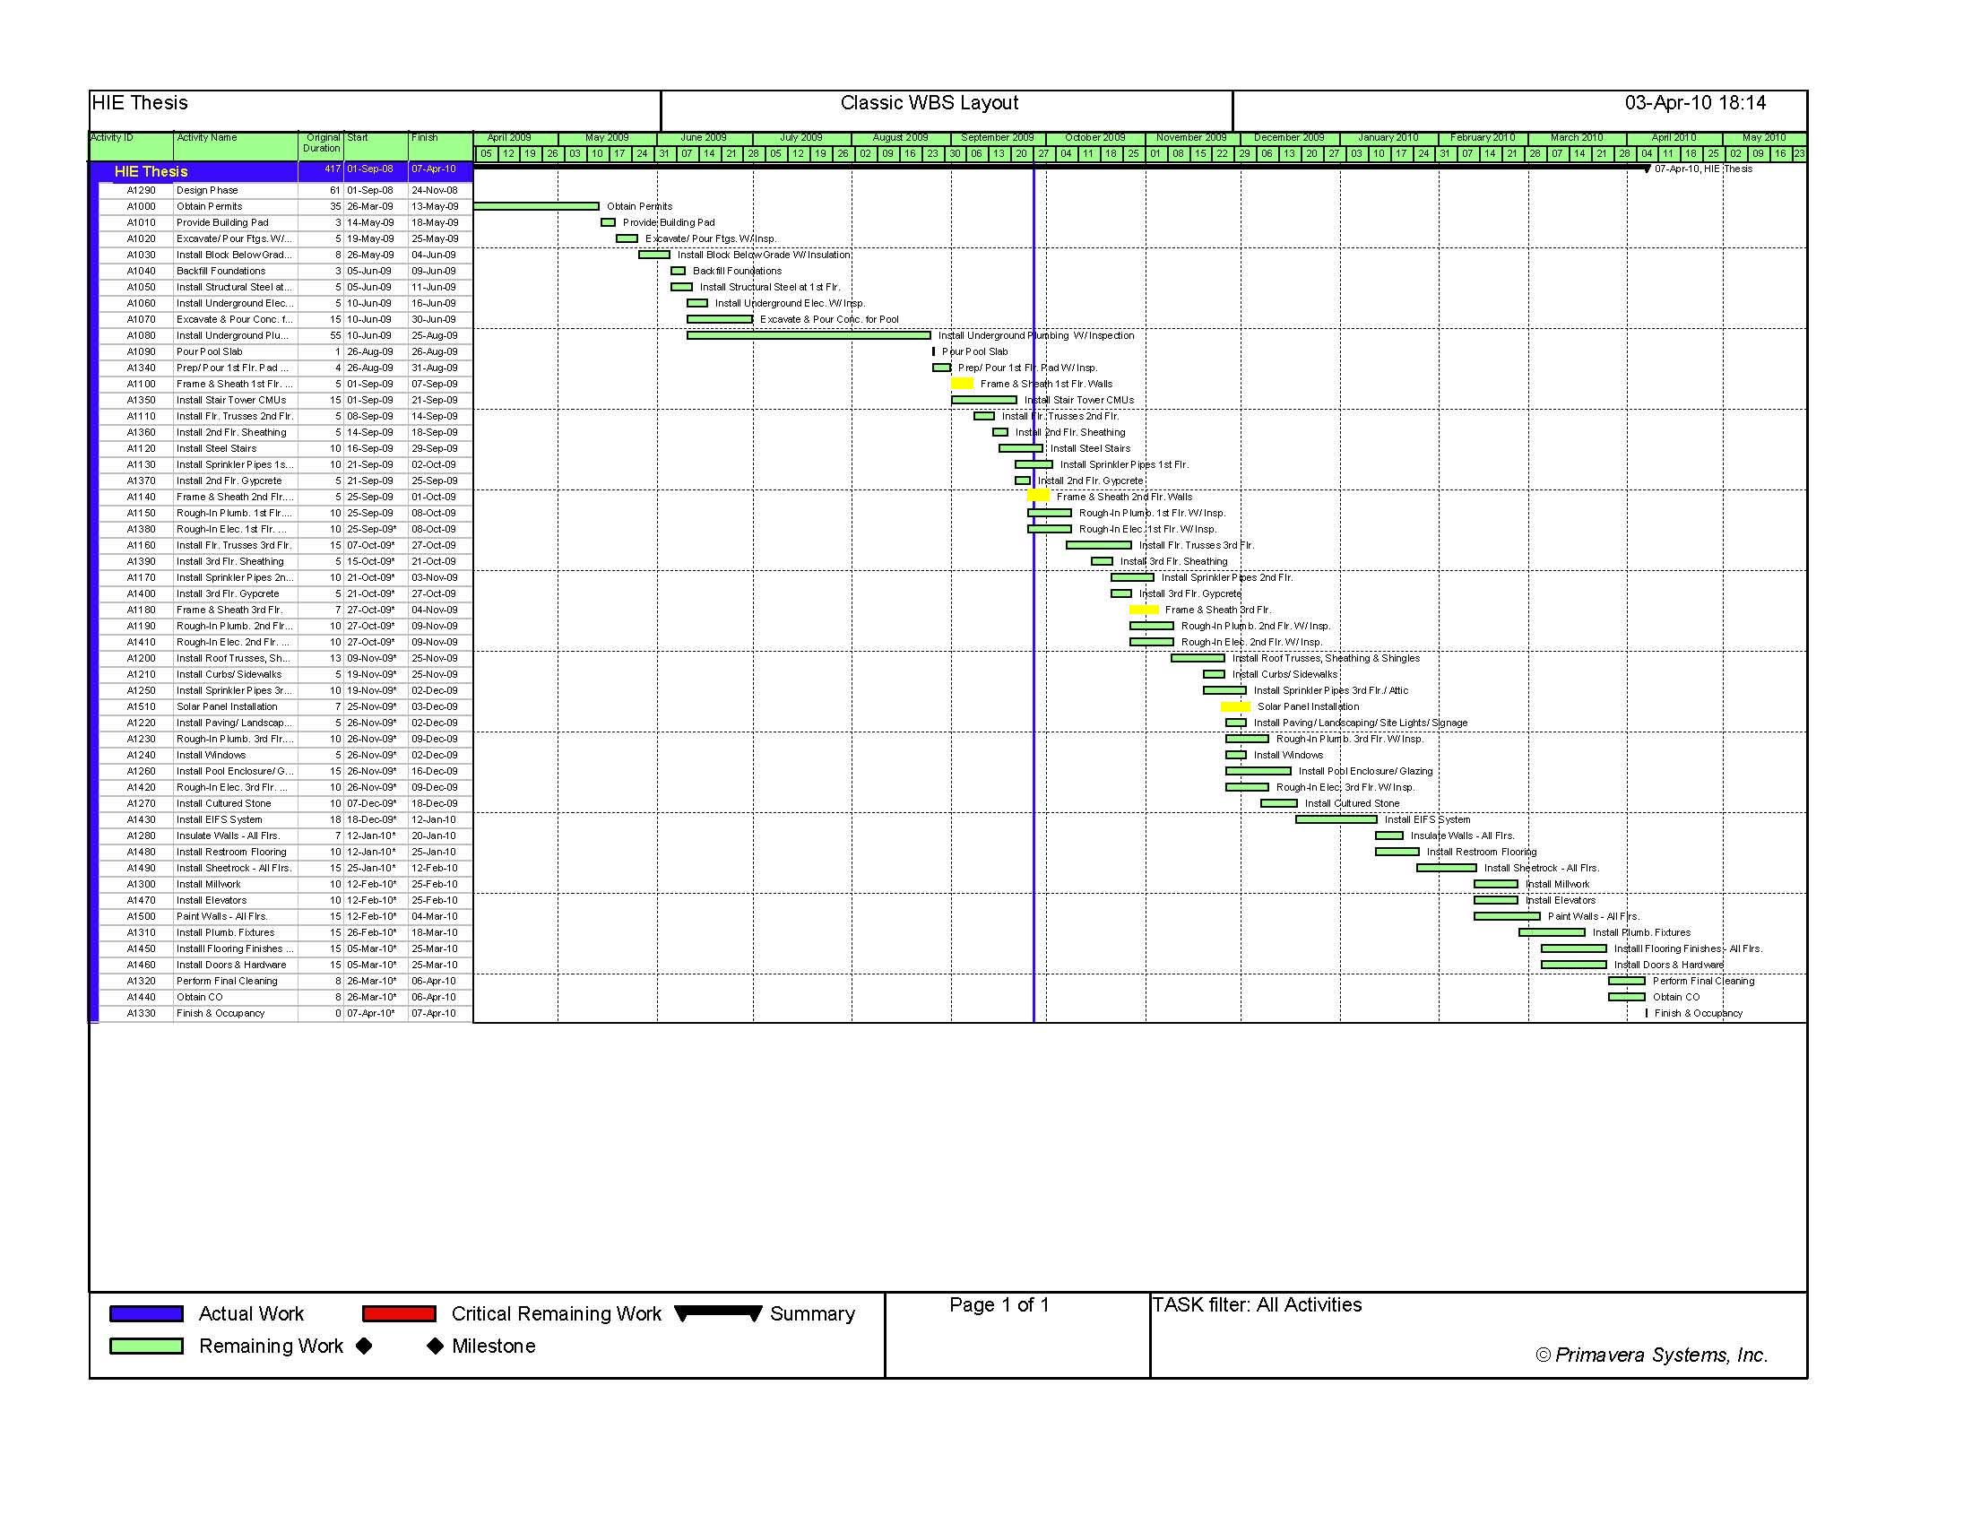
Outline
Holiday Inn Express
Additional Information
Introduction
Personal and Building Intro
Building Background
Building Size, Location, and Type
Current Budget and Schedule
Areas for Improvement/Client Influence
Analysis 1: Solyndra Solar Panel Implementation
Installation location
Sizing the Panel Layout
Schedule and Labor Analysis
Cost Analysis
Energy Savings Analysis/Payback
Analysis 2: SIP Panel Implementation
SIP Application
SIP vs. Stick Built
Material Cost
Schedule and Labor Analysis
Energy Savings Analysis/Payback
Analysis 3: BAS Systems
BAS System Application
Bathroom Nightlight motion Sensor
Hallway Motion Sensor
Motion Sensor PTAC
Conclusion
Final Schedule and Budget
Final Decisions (What and What Not to Proceed With)
Q/A
Final Schedule
Original Finish Date – April 16,2010
New Finish Date – April 7, 2010
Solar Panels – 6.25 day Installation period, doesn’t affect overall finish date
SIP Panel – 3 day Reduction/floor, 9 day overall schedule reduction
BAS Systems – Negligible

Slide 23
Outline
Holiday Inn Express
Additional Information
Introduction
Personal and Building Intro
Building Background
Building Size, Location, and Type
Current Budget and Schedule
Areas for Improvement/Client Influence
Analysis 1: Solyndra Solar Panel Implementation
Installation location
Sizing the Panel Layout
Schedule and Labor Analysis
Cost Analysis
Energy Savings Analysis/Payback
Analysis 2: SIP Panel Implementation
SIP Application
SIP vs. Stick Built
Material Cost
Schedule and Labor Analysis
Energy Savings Analysis/Payback
Analysis 3: BAS Systems
BAS System Application
Bathroom Nightlight motion Sensor
Hallway Motion Sensor
Motion Sensor PTAC
Conclusion
Final Schedule and Budget
Final Decisions (What and What Not to Proceed With)
Q/A
Final Budget
Two final budget analysis were made, with/without solar panels
The annual savings is 37% less w/o solar panels
The initial cost is 94% cheaper w/o solar panels
Final Payback
Payback Period (w/ Solar Panels) – 10 years
Payback Period (w/o Solar Panels) – 1 year

Slide 24
Outline
Holiday Inn Express
Additional Information
Introduction
Personal and Building Intro
Building Background
Building Size, Location, and Type
Current Budget and Schedule
Areas for Improvement/Client Influence
Analysis 1: Solyndra Solar Panel Implementation
Installation location
Sizing the Panel Layout
Schedule and Labor Analysis
Cost Analysis
Energy Savings Analysis/Payback
Analysis 2: SIP Panel Implementation
SIP Application
SIP vs. Stick Built
Material Cost
Schedule and Labor Analysis
Energy Savings Analysis/Payback
Analysis 3: BAS Systems
BAS System Application
Bathroom Nightlight motion Sensor
Hallway Motion Sensor
Motion Sensor PTAC
Conclusion
Final Schedule and Budget
Final Decisions (What and What Not to Proceed With)
Q/A
Final Decisions
Solyndra Solar Panels
Produces about 22% of Entire Building Energy
Long Payback Period about 26 years
Almost 10% Increase in Initial Budget
More Beneficial for Owner to Wait (Carbon Tax, Solar Panel ↓ Cost, & ↑ Efficiency)
SIP Panels
Stronger, Quieter, & Straighter
Easy Installation
Faster installation, 9 day Schedule Reduction
55% More energy Efficient Than Stick Built
Quick Payback, 1 Year
Plausible for Owner
BAS Systems
Reasonable Reduction in Vacant Energy Consumption
Cheap Initial Cost
About $12,000/year Annual Savings
Easy Installation
Quick Payback, 1 year
Plausible for Owner

Slide 25
Outline
Holiday Inn Express
Additional Information
Introduction
Personal and Building Intro
Building Background
Building Size, Location, and Type
Current Budget and Schedule
Areas for Improvement/Client Influence
Analysis 1: Solyndra Solar Panel Implementation
Installation location
Sizing the Panel Layout
Schedule and Labor Analysis
Cost Analysis
Energy Savings Analysis/Payback
Analysis 2: SIP Panel Implementation
SIP Application
SIP vs. Stick Built
Material Cost
Schedule and Labor Analysis
Energy Savings Analysis/Payback
Analysis 3: BAS Systems and Wireless Controls
BAS System Application
Bathroom Nightlight motion Sensor
Hallway Motion Sensor
Motion Sensor PTAC
Conclusion
Final Schedule and Budget
Final Decisions (What and What Not to Proceed With)
Q/A
Question?
Thesis by: Josh Raphael
Architectural Engineering
Construction Management

